Slide 1

Message Passing Interface
SHAMJITH KV
Senior Technical Officer
shamjithkv@cdac.in
CDAC Knowledge Park
Nov 23, 2011
ACTS Training

Slide 2
Outline
Distributed architecture
Introduction to MPI
Popular MPI Calls
Nov 23, 2011
ACTS Training

Slide 3

Sequential Job
Nov 23, 2011
ACTS Training

Slide 4

Parallel
Nov 23, 2011
ACTS Training

Slide 5
Consider a Pattern Searching application
Simulation created a huge data file.
  In GBs.
Search for “ACTG” pattern in the text file.
  Algorithm
    Read lines and search for specified character combinations
Multiple simulations and multiple comparisons
Nov 23, 2011
ACTS Training

Slide 6


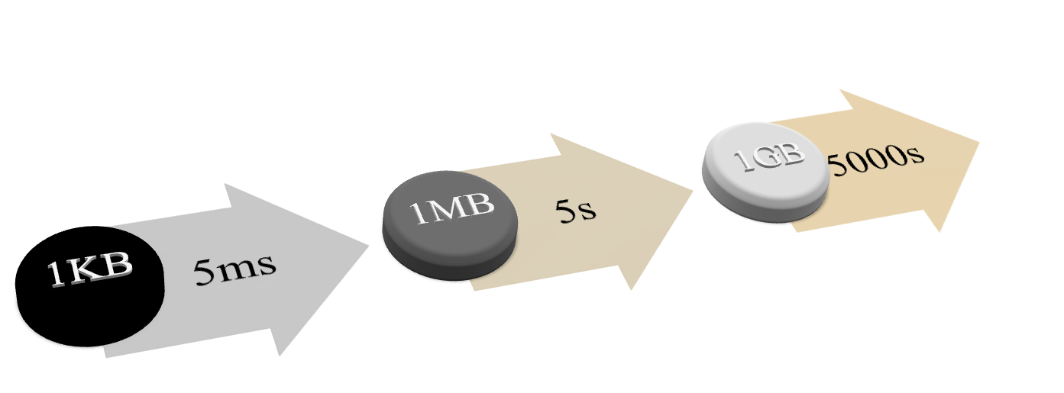

Single Computer
Compute Node
Reduce the processing time?
Nov 23, 2011
ACTS Training

Slide 7



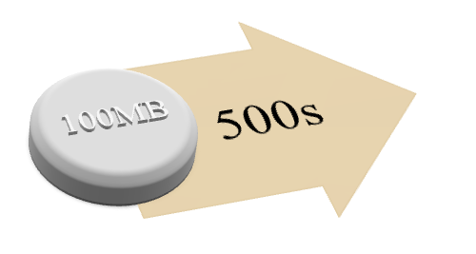

















10 Computing Resources
1
Compute Node
2
Compute Node
3
Compute Node
4
Compute Node
~
5
Compute Node
6
Compute Node
7
Compute Node
8
Compute Node
9
Compute Node
10
10
Compute Node
Nov 23, 2011
ACTS Training

Slide 8





















Cluster
1
Compute Node
2
Compute Node
3
Compute Node
4
Compute Node
5
Compute Node
Head Node
6
Compute Node
7
Compute Node
8
Compute Node
9
Compute Node
10
Compute Node
Nov 23, 2011
ACTS Training

Slide 9
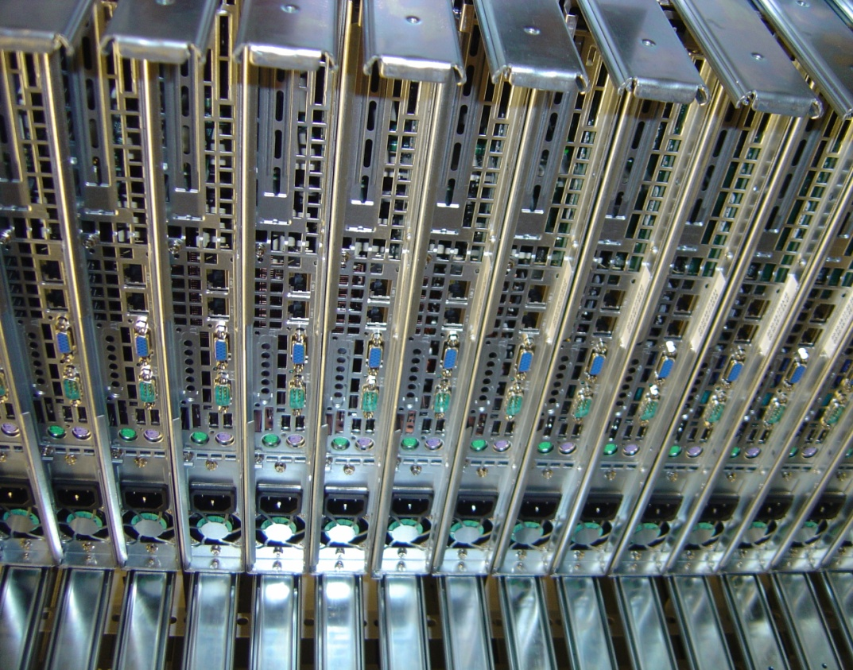
What is a Cluster
A computer cluster is a group of linked computers, working together closely thus in many respects forming a single computer.
The components of a cluster are connected to each other through fast local area networks
Nov 23, 2011
ACTS Training

Slide 10


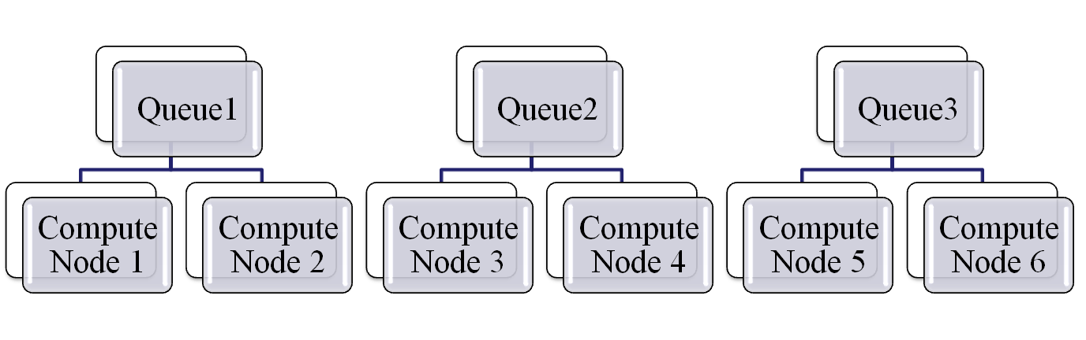
Computing Cluster
CLUSTER HEAD NODE
- Local Resource Manager
( Server , Scheduler, Job Execution Component)

Slide 11
PARALLEL COMPUTING MODELS
Nov 23, 2011
ACTS Training

Slide 12
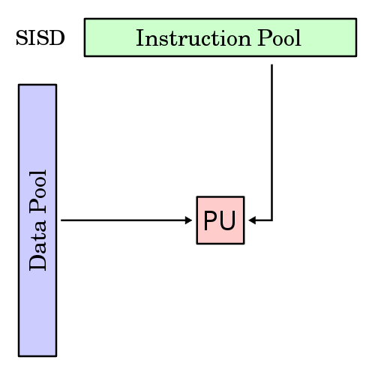
SISD
Nov 23, 2011
ACTS Training

Slide 13
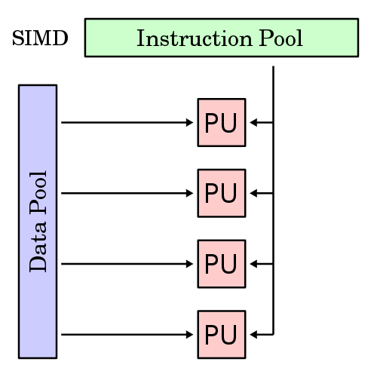
SIMD
Nov 23, 2011
ACTS Training

Slide 14
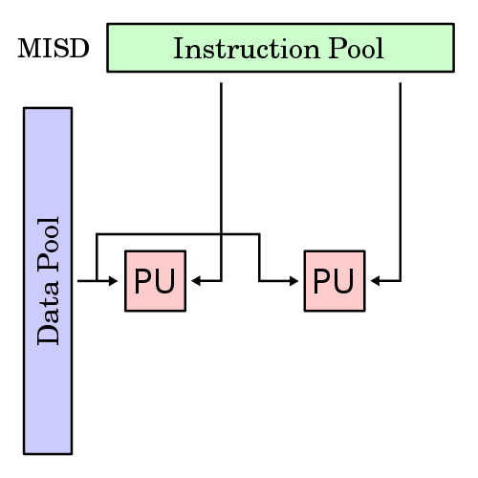
MISD
Nov 23, 2011
ACTS Training

Slide 15
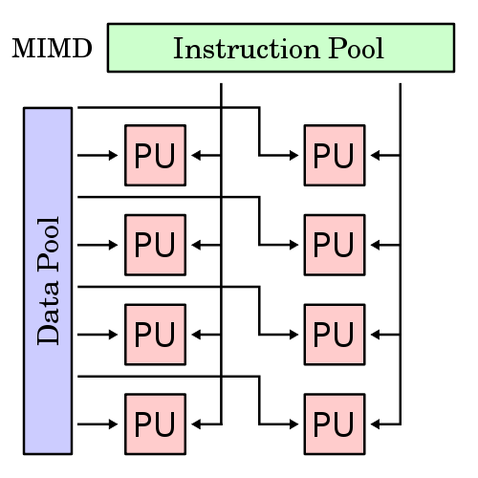
MIMD
Nov 23, 2011
ACTS Training

Slide 16
PARALLEL APPLICATION – CLOSER LOOK
Nov 23, 2011
ACTS Training

Slide 17
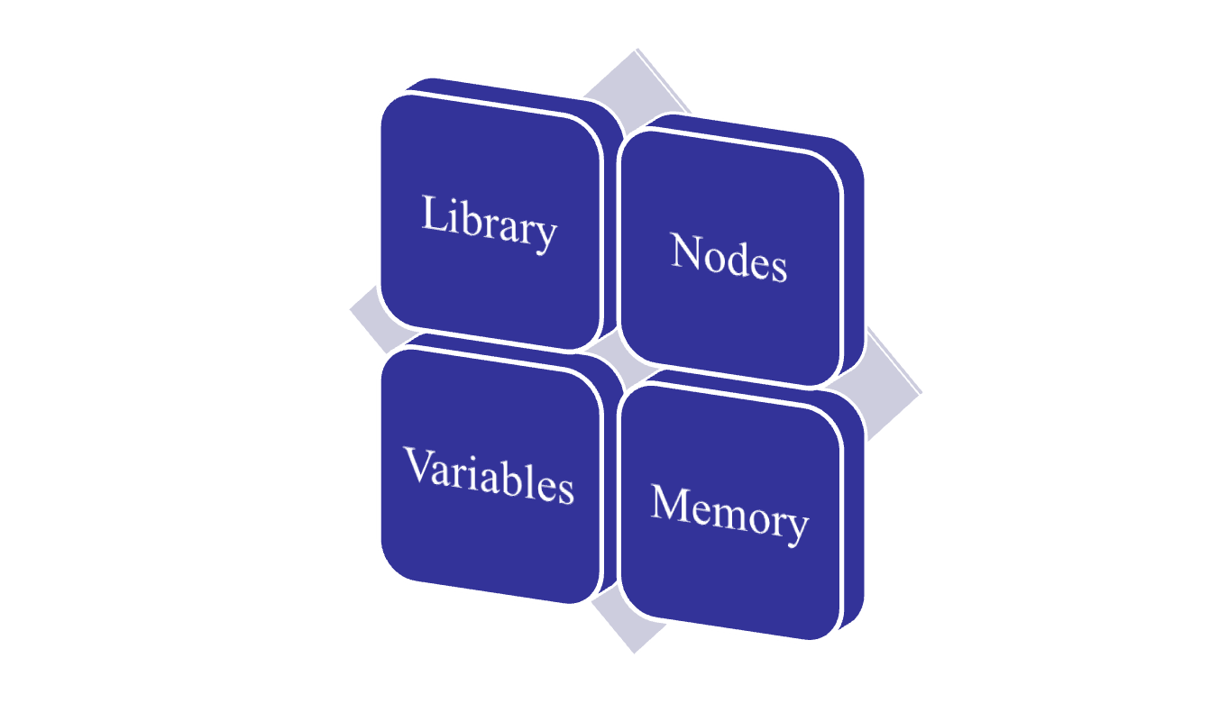
Environment Initialization
Nov 23, 2011
ACTS Training

Slide 18

Identify yourself and members in the Team
Nov 23, 2011
ACTS Training

Slide 19
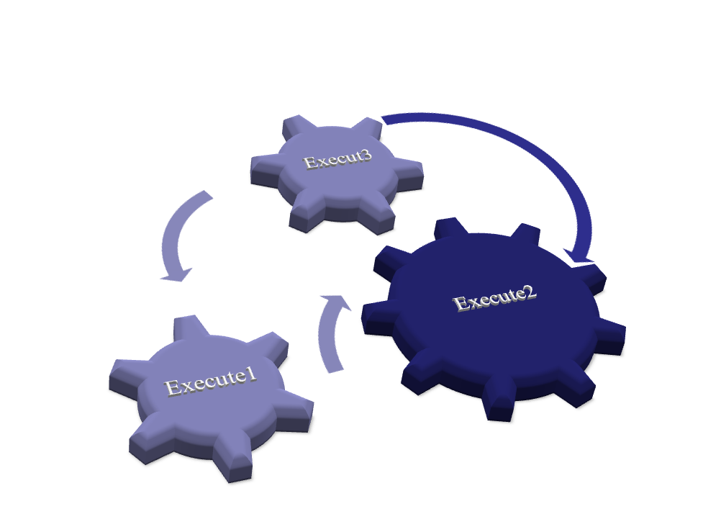
Algorithm Execution and Communication
Nov 23, 2011
ACTS Training

Slide 20






Collect and Consolidate Output/Data
C
O
N
S
O
L
I
D
A
T
E
Final Output
Nov 23, 2011
ACTS Training

Slide 21
Release the Environment
Nov 23, 2011
ACTS Training

Slide 22
HOW CAN WE WRITE PARALLEL PROGRAMS?
Nov 23, 2011
ACTS Training

Slide 23
What is MPI
A message passing library specification
Message passing among processes in parallel computing
Meant for clusters and network of workstations
Message Passing Standard for Parallel Programs
  MPI Implementation left to individual vendors.
  Most commonly supports C, Fortran, C++ programs
Nov 23, 2011
ACTS Training

Slide 24
Features of MPI Implementation
Allow efficient Communication between processes.
Implementable in heterogeneous environment.
Allow overlap of computation and communication
Nov 23, 2011
ACTS Training

Slide 25
MPI Implementations
MPICH(Public Domain)
LAM/MPI
SUN MPI
IBM MPI
C-MPI (from C-DAC)
Nov 23, 2011
ACTS Training
Notes:
LAM: Local Area Multicomputer

Slide 26







Structure of MPI Program
Include MPI Header File
Initialize MPI Environment
MPI Communicator Details
MPI Rank Details
Parallel Algorithm Implementation
Collect and Consolidate Output
Finalize MPI
Nov 23, 2011
ACTS Training

Slide 27
Sample MPI Program
#include <stdio.h>
#include <mpi.h>
void main(int argc, char *argv[]) {
int rank, size;
MPI_Init(&argc, &argv); MPI_Comm_rank(MPI_COMM_WORLD, &rank); MPI_Comm_size(MPI_COMM_WORLD, &size);
printf("Process:%d out of %d\n", rank, size); MPI_Finalize();
}
Nov 23, 2011
ACTS Training

Slide 28
Necessary points required to learn
MPI Programming
MPI Data types
Format of MPI Calls
Communicator
Rank
Communications
  Point to point communication
  Collective communication
Nov 23, 2011
ACTS Training

Slide 29
MPI Basic Data types - C Programs
MPI Data type
C Data type
MPI_CHAR
Signed char
MPI_SHORT
Signed short int
MPI_INT
Signed int
MPI_LONG
Signed long int
MPI_UNSIGNED_CHAR
Unsigned char
MPI_UNSIGNED_SHORT
Unsigned short int
MPI_UNSIGNED
Unsigned int
MPI_UNSIGNED_LONG
Unsigned long int
MPI_FLOAT
Float
MPI_DOUBLE
Double
MPI_LONG_DOUBLE
Long double
MPI_BYTE
Nov 23, 2011
ACTS Training

Slide 30
Format of MPI Calls
Format | Rc = MPI_Xxxxx(parameter, ... )
Ex | Rc = MPI_Bsend(&buf,count,type,dest,tag,comm)
All MPI Functions are case sensitive.
All MPI calls begin with MPI_ followed by actual function name.
C programs should include the file mpi.h
Return_integer Rc is of type integer. It is set to MPI_SUCCESS upon success.
Nov 23, 2011
ACTS Training

Slide 31
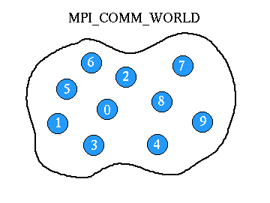
MPI Communicator
The communicator is Communication Universe.
  Processes that are allowed to communicate
Messages are sent / received within a given Universe.
MPI_COMM_WORLD is the default communicator.
Nov 23, 2011
ACTS Training

Slide 32
What is Rank in Communicator
Unique integer identifier for every process.
Assigned by the system during initialization.
Ranks are contiguous & begin at zero.
Used to specify the source and destination of messages.
Often used to control program execution (if rank=0 do this / if rank=1 do that).
Nov 23, 2011
ACTS Training

Slide 33
MPI Communications
Point-to-Point Communication
  Blocking
  Non Blocking
Collective Communication
  Synchronization
  Collective computation
  Data Movement
Nov 23, 2011
ACTS Training

Slide 34
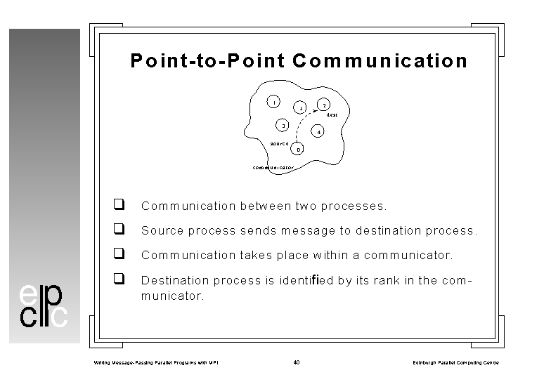
MPI Point-to-Point Communication
Communication between two processes.
Source process sends message to destination process.
Communication takes place within a communicator.
Destination process identified by its rank in the communicator.
Nov 23, 2011
ACTS Training

Slide 35
MPI Send and Receive: Blocking
  strcpy(Message, "Hello India");
Destination = 0; iproc = 1; BUFFER_SIZE = 32;
MPI_Send (Message, BUFFER_SIZE, MPI_CHAR, Destination, tag,MPI_COMM_WORLD);
MPI_Recv(Message, BUFFER_SIZE, MPI_CHAR, iproc, tag,MPI_COMM_WORLD, &status);
  Arguments of MPI_send & Receive:
  Message: Address where the data starts.
  BUFFER_SIZE: Number of elements (items) of data in the message.
  MPI_CHAR: Datatype of the message passed / received.
  Destination/iproc: Sending or Receiving processes
  tag: Integer to distinguish messages
  MPI_COMM_WORLD: Communicator, status: contains status
Nov 23, 2011
ACTS Training

Slide 36
MPI Send and Receive: Syntax
  int MPI_Send(void *buf, int count, MPI_Datatype dtype, int dest, int tag, MPI_Comm comm);
  int MPI_Recv(void *buf, int count, MPI_Datatype dtype, int source, int tag, MPI_Comm comm, MPI_Status *status);
  When MPI_Recv routine returns, the received message data have been copied into the buffer; and the tag, source, and actual count of data received are available via the status argument
Nov 23, 2011
ACTS Training

Slide 37
A very simple MPI Program
#include <stdio.h>
#include <mpi.h>
void main(int argc, char *argv[]) {
int rank, size;
MPI_Init(&argc, &argv); MPI_Comm_rank(MPI_COMM_WORLD, &rank); MPI_Comm_size(MPI_COMM_WORLD, &size);
printf("Process:%d out of %d\n", rank, size); MPI_Finalize();
}
Nov 23, 2011
ACTS Training

Slide 38
Example MPI Program with Send/Receive
#include <stdio.h>
#include "mpi.h"
#include <string.h>
#define BUFFER_SIZE 32
int main(int argc,char *argv[])
{
int MyRank,Numprocs,Destination,iproc, tag = 0, Root=0, temp = 1;
char Message[BUFFER_SIZE];
MPI_Status status;
MPI_Init(&argc,&argv);
MPI_Comm_rank(MPI_COMM_WORLD,&MyRank);
MPI_Comm_size(MPI_COMM_WORLD,&Numprocs);
if(MyRank == 0) {
strcpy(Message, "Hello India");
for (temp=1; temp<Numprocs;temp++)
MPI_Send(Message, BUFFER_SIZE, MPI_CHAR, temp, tag,MPI_COMM_WORLD);
}
else {
MPI_Recv(Message, BUFFER_SIZE, MPI_CHAR, Root, tag,MPI_COMM_WORLD, &status);
printf("\n%s in process with rank %d from Process with rank %d\n", Message,MyRank,Root);
}
MPI_Finalize();
}
Nov 23, 2011
ACTS Training

Slide 39
Compiling and Running MPI Programs
$ mpicc filename.c
$ mpirun –np <np> –machinefile <hostfilesname> [opt] <exe-name>
  Where
  -np: No. of process to run on
-machinefile : List of possible machines to run the executable
Nov 23, 2011
ACTS Training

Slide 40
Non-Blocking Send and Receive: Syntax
  int MPI_Isend(void *buf, int count, MPI_Datatype dtype, int dest, int tag, MPI_Comm comm, MPI_Request *request);
  int MPI_Irecv(void *buf, int count, MPI_Datatype dtype, int source, int tag, MPI_Comm comm, MPI_Request *request);
Nov 23, 2011
ACTS Training

Slide 41
Example MPI Program with Isend/Irecv
#include <stdio.h>
#include <mpi.h>
void main (int argc, char **argv) {
int myrank;
MPI_Request request;
MPI_Status status;
double a[100], b[100];
MPI_Init(&argc, &argv); /* Initialize MPI */ MPI_Comm_rank(MPI_COMM_WORLD, &myrank);
/* Get rank */
Nov 23, 2011
ACTS Training

Slide 42
Example MPI Program with Isend/Irecv
if( myrank == 0 ) {
/* Post a receive, send a message, then wait */
MPI_Isend( b, 100, MPI_DOUBLE, 1, 19, MPI_COMM_WORLD, &request );
MPI_Send( a, 100, MPI_DOUBLE, 1, 17, MPI_COMM_WORLD );
MPI_Wait( &request, &status );
}
else if( myrank == 1 ) {
/* Post a receive, send a message, then wait */
MPI_Irecv( b, 100, MPI_DOUBLE, 0, 17, MPI_COMM_WORLD, &request );
MPI_Recv( a, 100, MPI_DOUBLE, 0, 19, MPI_COMM_WORLD );
MPI_Wait( &request, &status );
}
MPI_Finalize(); /* Terminate MPI */
}
Nov 23, 2011
ACTS Training

Slide 43

THANK YOU
Nov 23, 2011
ACTS Training

Slide 44
MPI Point-to-Point Communication Modes
Send Modes | MPI function | Completion Condition
Synchronous send | MPI_Ssend | only completes when the receive has completed
Buffered send | MPI_Bsend | always completes (unless an error occurs) irrespective of the receiver
**Standard send | MPI_Send | message sent (receive state unknown)
Ready send | MPI_Rsend | may be used only when the a matching receive has already been posted
Nov 23, 2011
ACTS Training

